Slide 1
Data Structure & Algorithms
.

Slide 2


./.
.

Slide 3

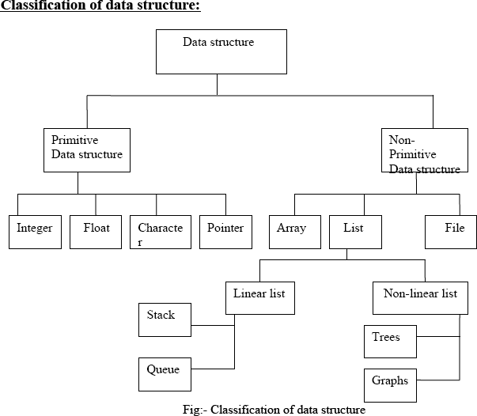
./.
.

Slide 4
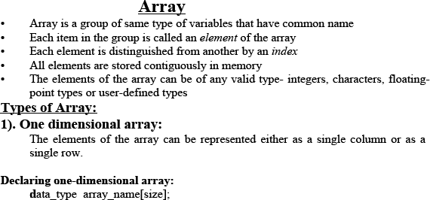


./.
.

Slide 5

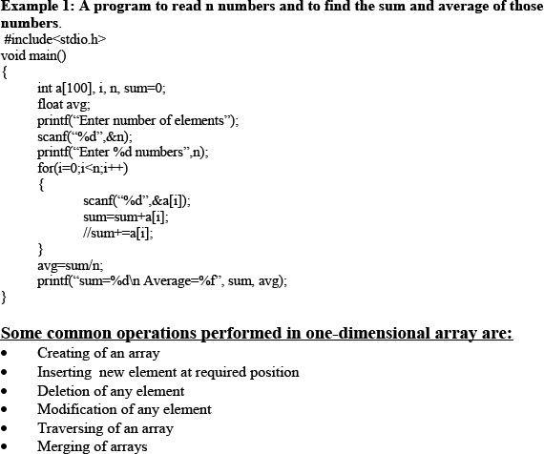
./.
.

Slide 6
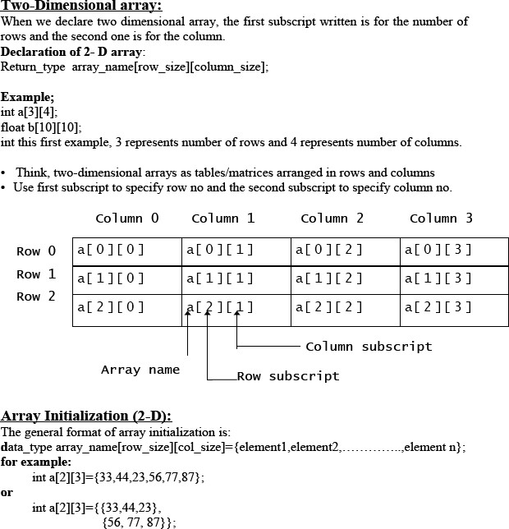
./.
.

Slide 7
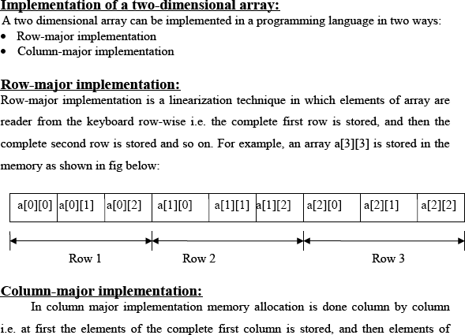
./.
.

Slide 8
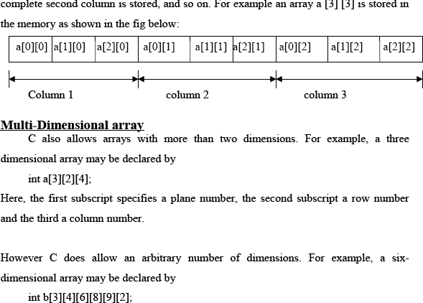
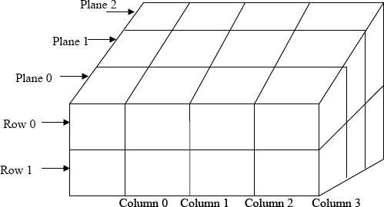
./.
.

Slide 9

./.
.

Slide 10
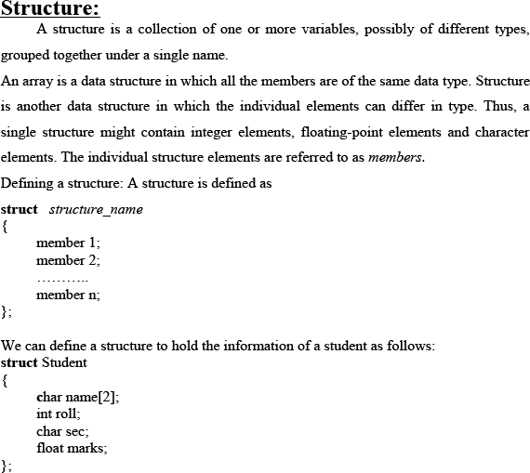

./.
.

Slide 11

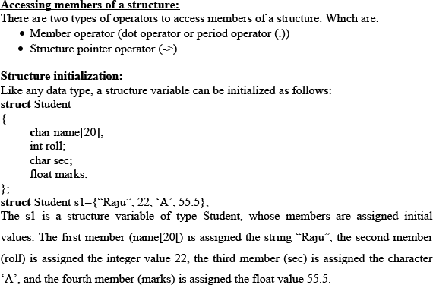
./.
.

Slide 12
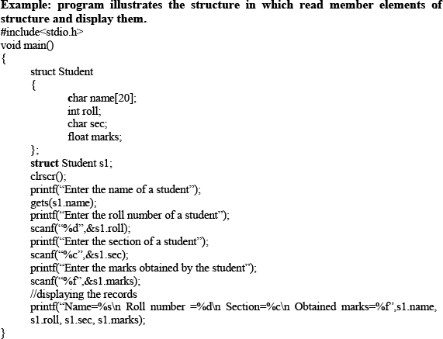
./.
.

Slide 13
Thank You All
Any Questions?
./.
.

